Slide 1


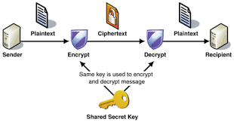
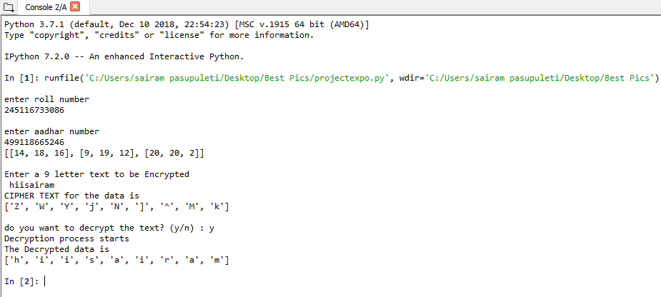
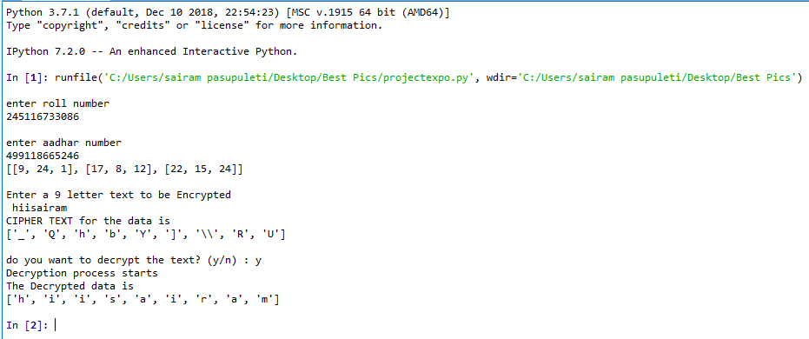
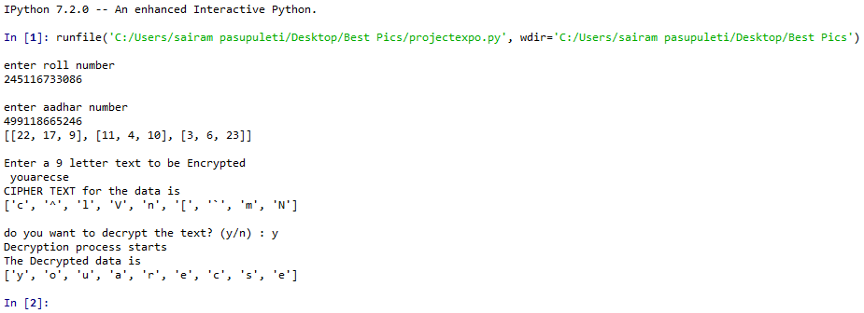
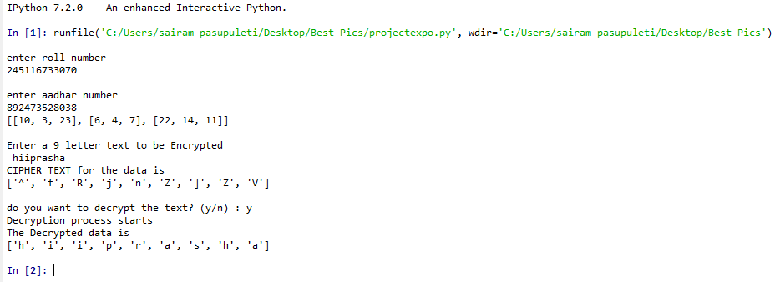
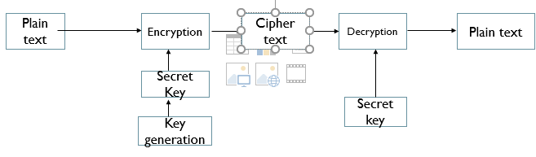
INSTANT MESSAGING SECURITY
P.Sairam, Ps.Prashanth, M.Chandrashekar,M.Sahith Guide : Dr.H.Jayashree
abstract
Flow Chart
results
An Symmetric Cryptography algorithm was developed that can be used in the data security, which overcomes the many defects of the RSA algorithm that is mostly used ,The algorithm we have developed occurs in three phases
1)key generation
2)encryption of plain text to generate a cipher text
3)decryption to get plain text back from cipher text
We have used random matrix in key generation which is the main thing in the algorithm which was developed because each time if you enter the same inputs which we have taken as roll number and aadhar number and if you enter same message also generates the different cipher text ,so that the algorithm cannot be traced back to find the plain text..the algorithm which was developed cannot be predicted back to obtain plain text so that it provides good security.
objectives
Same inputs and text entered but generates a different cipher text which is unique.
To develop a better algorithm that cannot be traced back than traditional RSA algorithm which can be traced back.
To develop a Cryptography algorithm which gives good security to the data or messages..
COMPARISON WITH RSA ALGORITHM
METHOD
When the cipher text is known in the RSA algorithm the algorithm can be traced back by finding the matches and the plain text can be predicted while in the algorithm we have developed each time if same inputs are entered generates a unique cipher text, even if same text and same inputs are entered generates a unique cipher text and a unique key by which the algorithm cannot be traced back and there is good security for data.
The algorithm we have developed is much faster than RSA algorithm
The algorithm we have developed requires less inputs compared to the RSA algorithm
Can be easily understood and simple.
In RSA algorithm if public key is known the private key can be easily found but in the algorithm we have developed is unique and cannot be found by anyone.
An Symmetric key cryptography algorithm was developed which overcomes the defects of RSA algorithm which can be traced back but the algorithm which was developed cannot be traced back and cannot be predicted .
The algorithm occurs in three phases:
1)Key Generation
2)Encryption
3)Decryption
1)Key Generation: User Credentials are accepted which includes roll number and Aadhar card number and they are stored and a random matrix is generated which plays an important role in the algorithm developed using the above numbers a key is generated.
2)Encryption : The message is entered which is the plain text and using the key generated in the above phase the plain text is converted to cipher text which cannot be understood so that the unauthorised users cannot access the plain text.
3)Decryption : Using the cipher text which is generated and the key the message is decrypted back and plain text is generated back.
Same inputs but different text is entered even generates a unique cipher text
Different inputs and different text even unique cipher text is generated
conclusions
An effective symmetric key cryptography algorithm was developed which will overcome the many defects of RSA algorithm and provides data security.
It can be applied and used in various messaging applications , it can also be used in our college even for sharing data between different branches servers but the other branches servers or main server should not understand it ,the algorithm we have developed can be applied

